Slide 1

Multi-Wire Proportional Counter (MWPC)
- a position sensitive detector for fission fragment detection
By:
Meemik Roy
Sri Venkateswara College, Delhi University
Under the guidance of: Mr. Saneesh N Scientist, IUAC

Slide 2

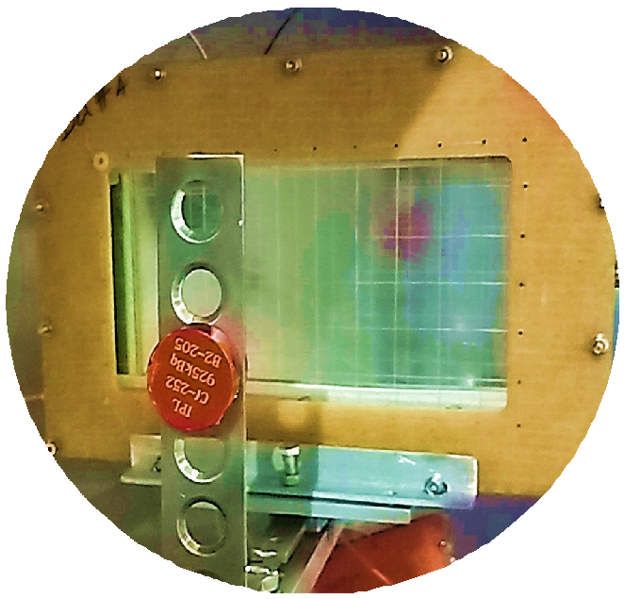

1 Introduction
2
Multi-Wire Proportional Counter
3
Delay Line Test
4
Source Test
5
Time of Flight Measurement

Slide 3

Introduction

Slide 4

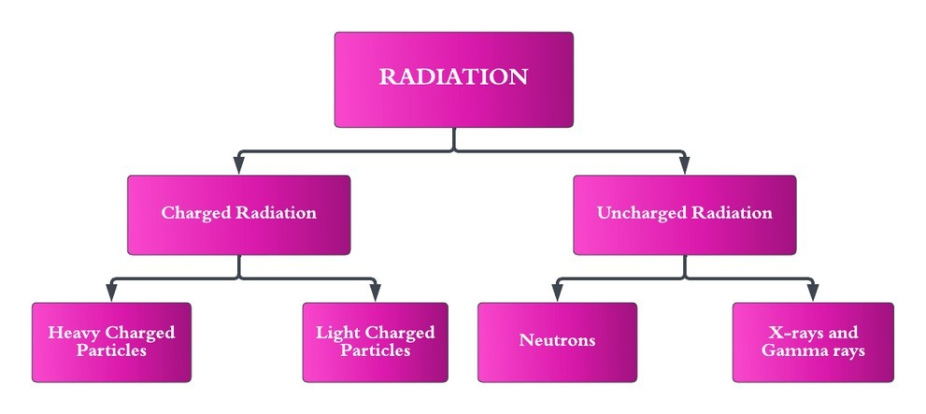

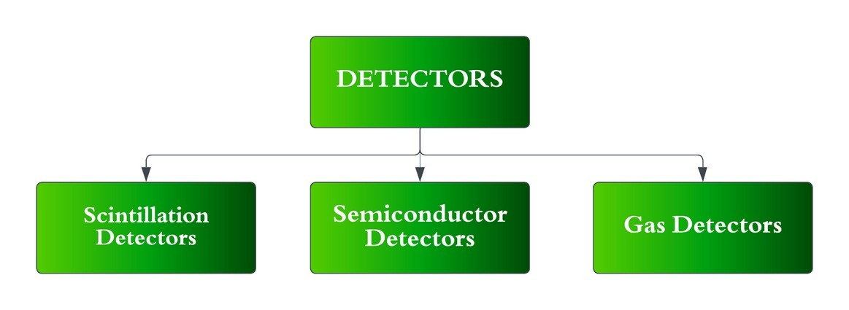
RADIATION DETECTORS
Instruments used to detect or identify high-
energy particles.
Its operation basically depends on the manner in which the radiation interacts with the material of detector.
HEAVY CHARGED PARTICLE DETECTORS
Heavy Charged particles interact with matter through Coulomb Forces between the incoming radiation and detector.

Slide 5
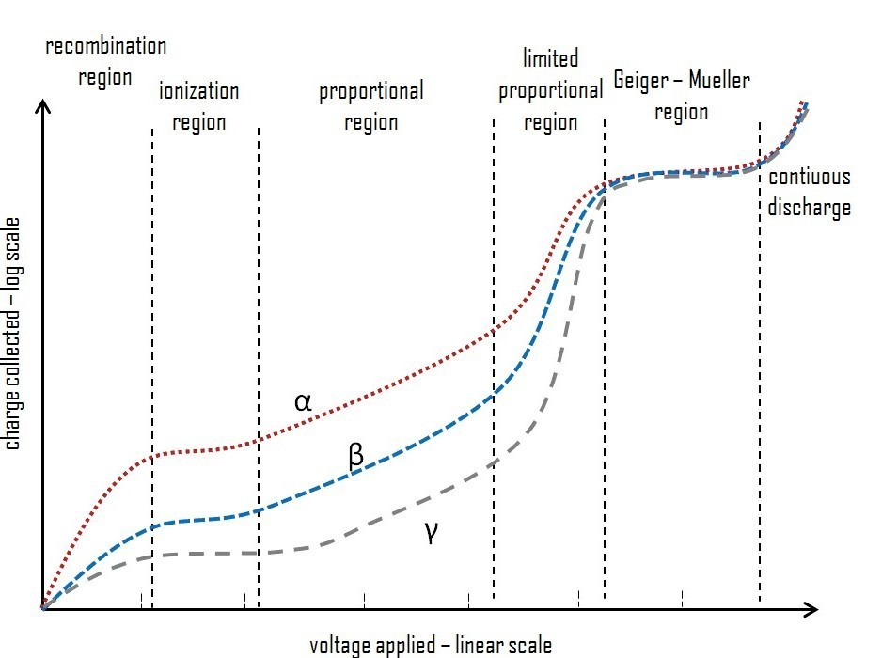
GAS DETECTORS
Are based on the effects produced when a charged particle passes through a gas. Primary modes of interaction involve ionization and excitation of a gas molecule.
Gas detectors are widely used because they: Are insensitive to radiation damage, Have high count rate handling capability, Can be easily fabricated with ease in various sizes (big as well as small) and geometry to make it compatible with given experimental requirements

Slide 6

Multi-Wire Proportional Counters (MWPC)

Slide 7
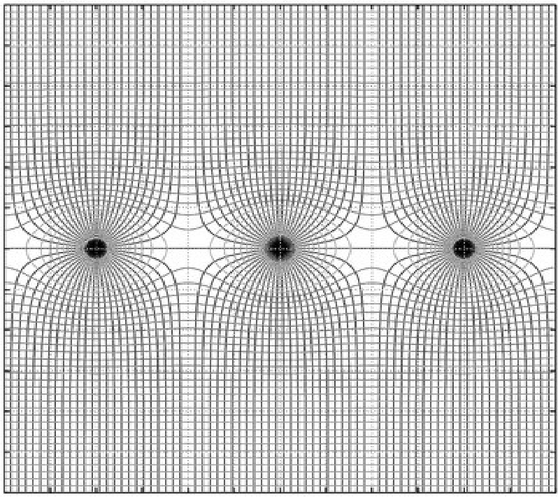
Basic operating principles
•
Basic MWPC consists of plane of equally spaced anode wires centered between two cathode planes.
The main properties include very good time resolution, good position accuracy and self-triggered operation
When a negative voltage is applied to cathode planes, an electric field shown in alongside figure.
•
•

Slide 8

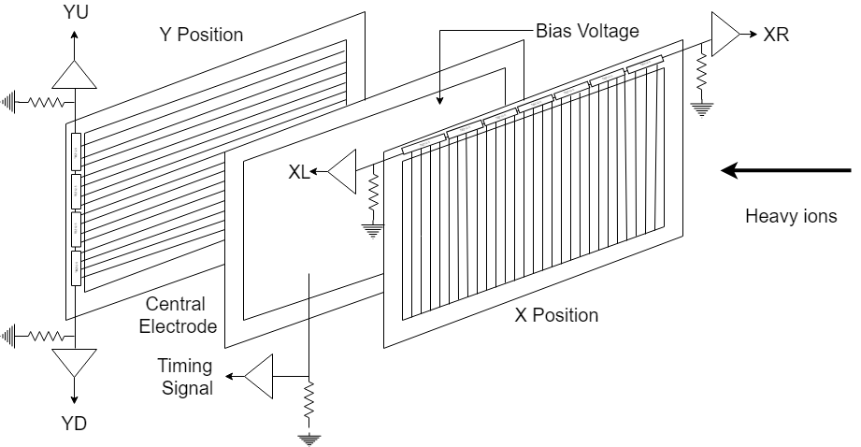
Detector Construction
•
The X-position electrode is a wire plane made of 240 gold plated tungsten wires of diameter 20µm mounted on a 3.2mm thick PCB frame.
The Y-position frame is a strip plane made of 80 strips of width 0.7mm and pitch 1.27mm. The electrodes are placed symmetrically with 3.2mm spacing between them.
The entire electrode assembly is
mounted inside a rectangular aluminum chamber and is isolated from the surroundings using 6µm thick mylar foil and is supported by crossed nylon wires to avoid bulging.
•
MWPC has three electrode geometry with active area of 20cm x 10cm.
It consists of a central cathode, made of double sided aluminized mylar (polyethylene terephthalate) of thickness 2µm stretched on a 2.4mm thick PCB frame sandwiched between two electrodes, the X and Y position electrode.
•
•
•

Slide 9


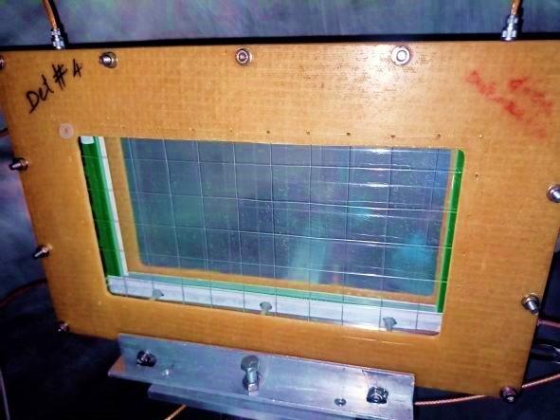
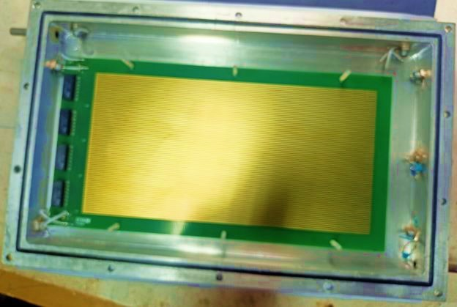


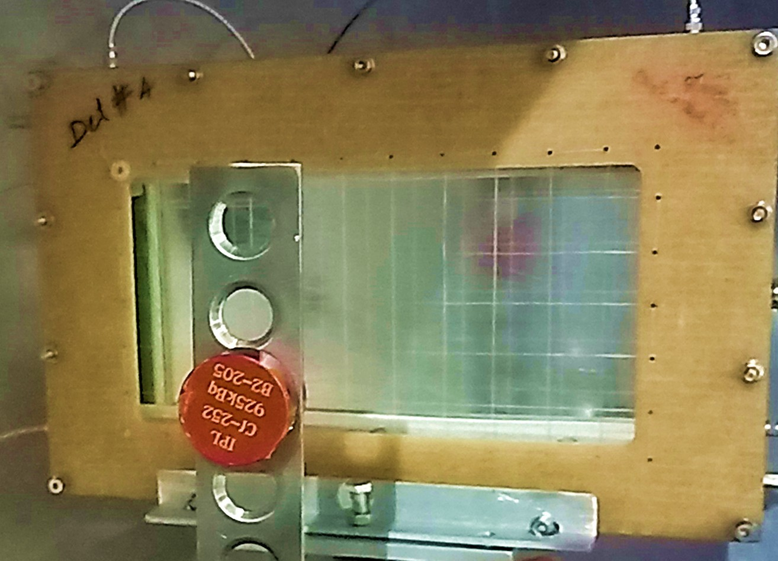
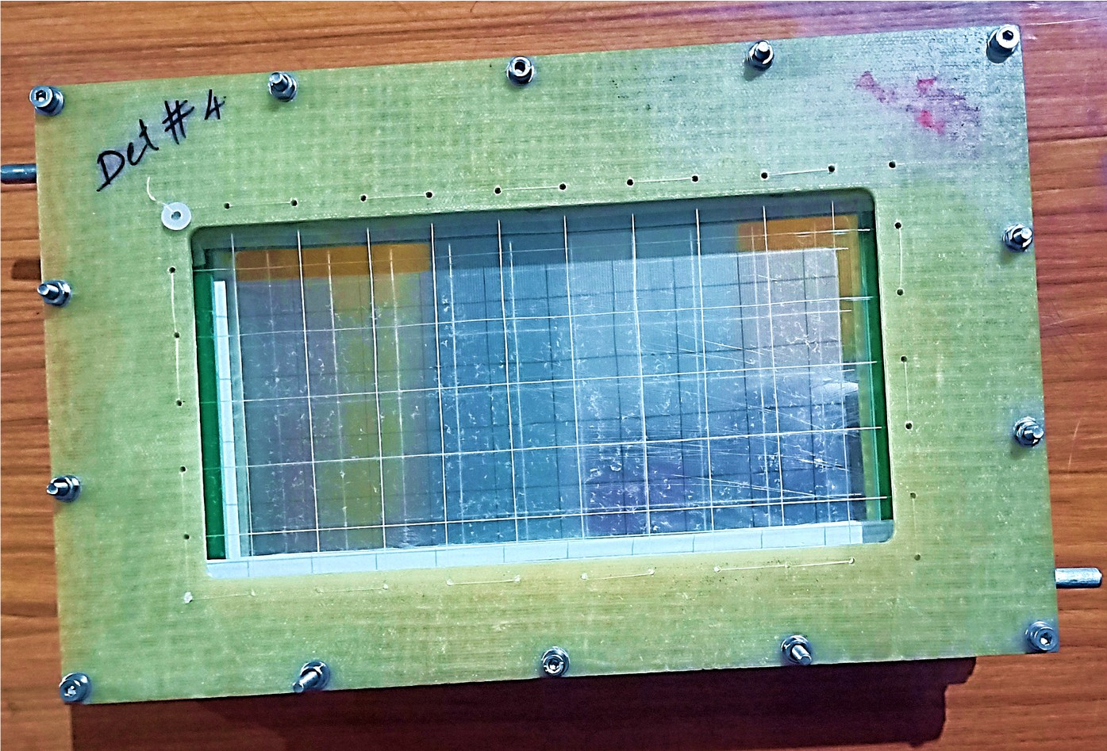

Slide 10

Delay Line Test

Slide 11
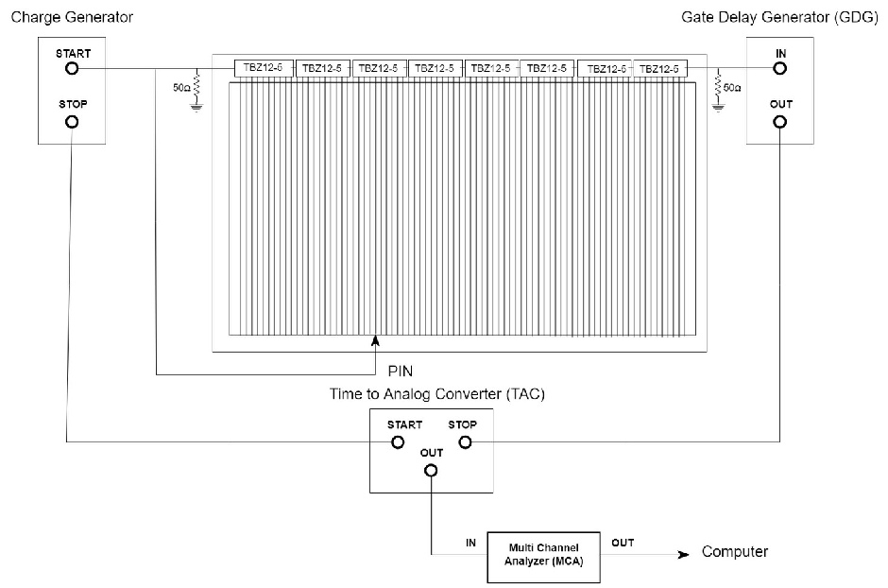

Delay Line Test
Known delays were induced using commercially available Rhombus Industries TZB12-5 10 tap high performance passive delay chips. Each chip induces 20 ± 1.0ns delay from end-to-end and a delay of 2±0.5ns between each tap
The position electrodes were tested for their delays between the taps so as to remove any faulty chips that are inducing incorrect delays. The X-position electrode has 8 chips and 3 wires shorted between each tap (240 wires in total) The Y-position has 4 chips and 2 strips shorted between each tap (80 strips in total).

Slide 12
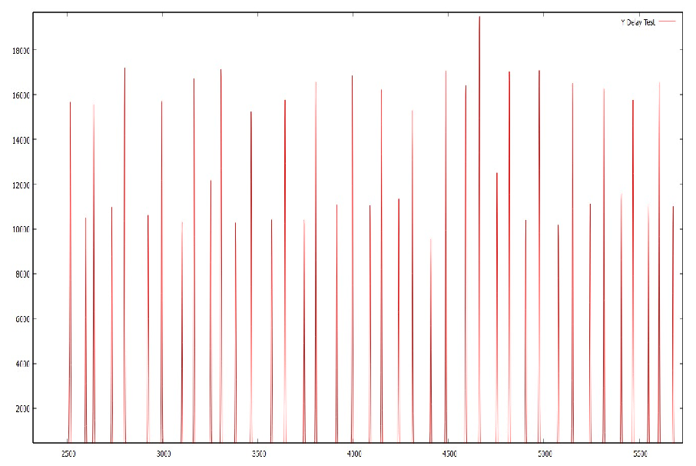
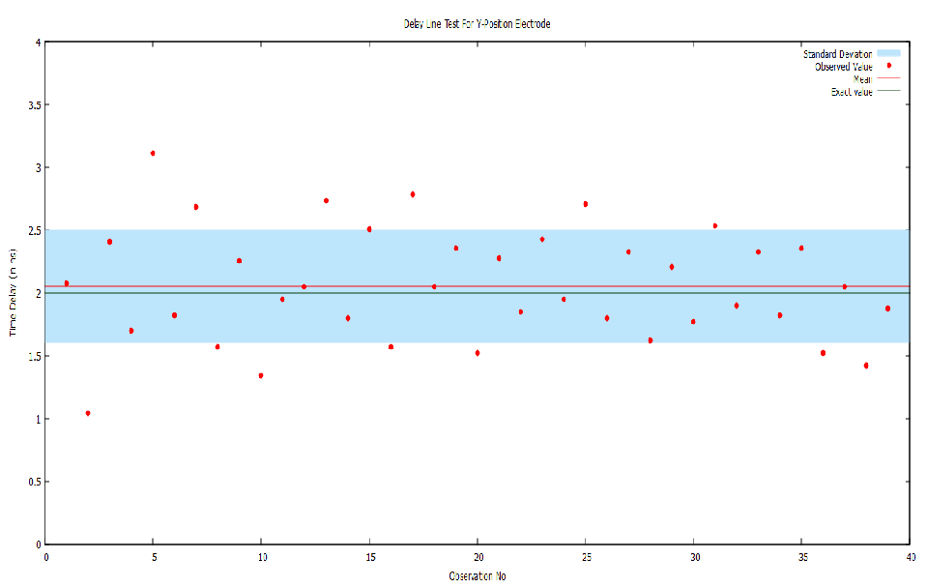
Results
Each tap in the chip is providing 2±0.5ns delay which is within the prescribed values

Slide 13

Leak Test of Detector Chamber

Slide 14
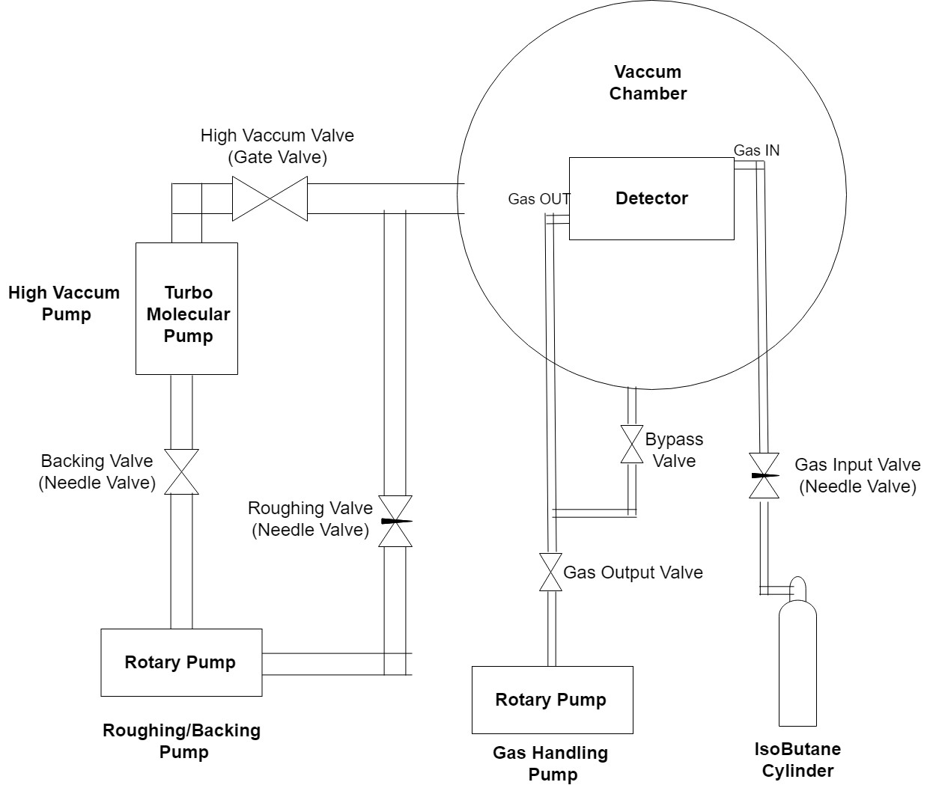
Leak test
•
The MWPC is kept inside a vacuum chamber and both are simultaneously pumped down to high vacuum.
MWPC is isolated from the vacuum chamber and a steady flow of gas is maintained and any deterioration in the chamber vacuum is noticed.
Leak testing shows no noticeable leak when the vacuum chamber was operated at 4x10−6mbar and a steady flow of 5mbar is maintained in the MWPC.
•
•

Slide 15

Source Test

Slide 16

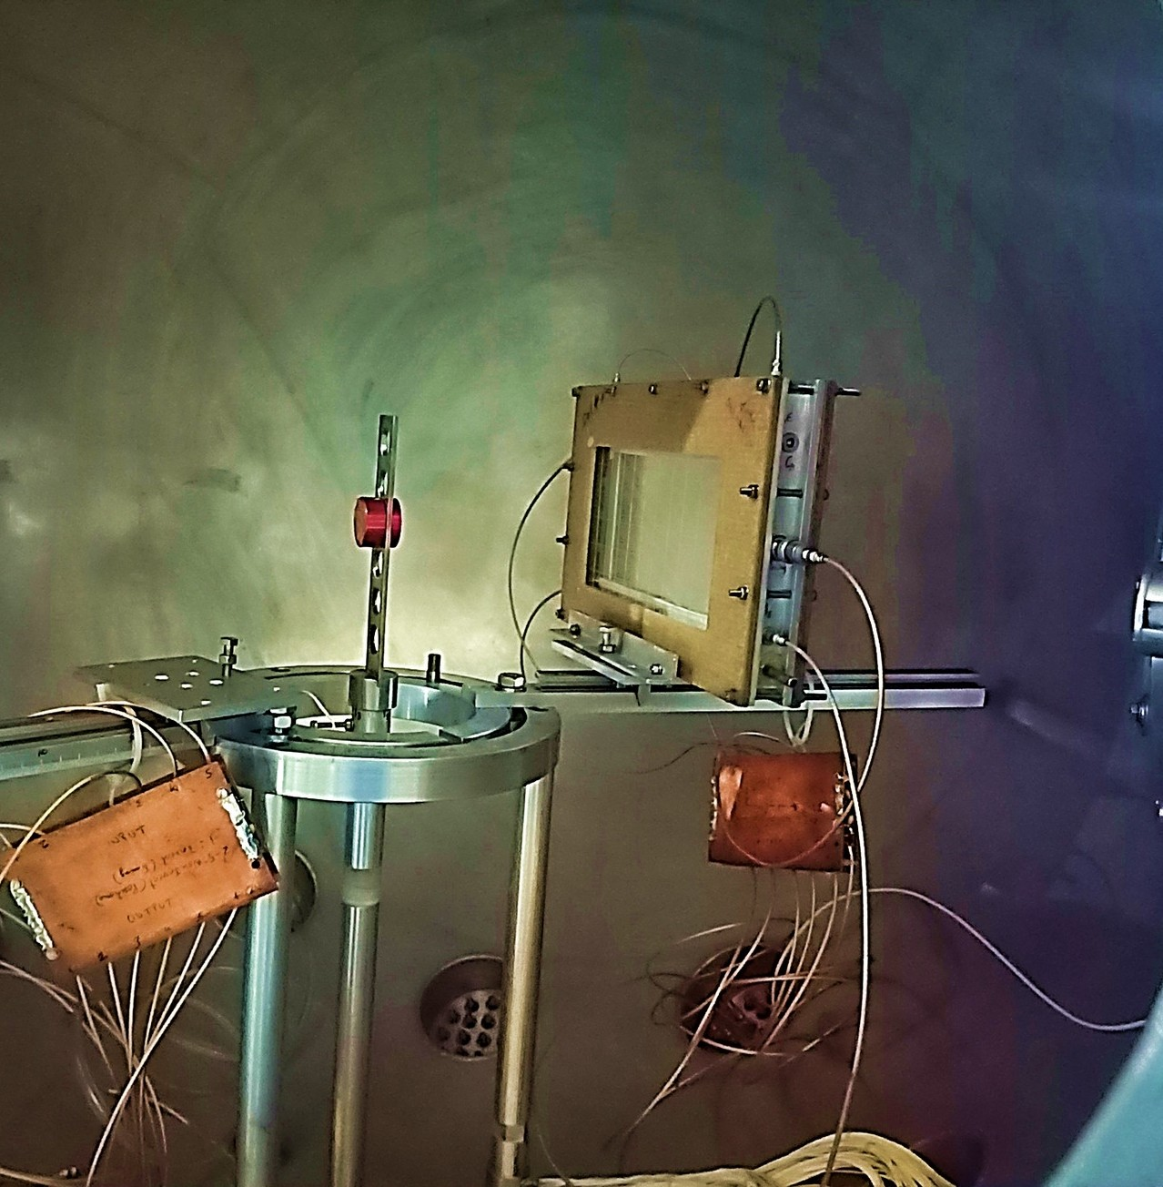
Source Test
•
Performance of MWPC is being tested using a fission source test
Cf-252 spontaneous fission source with strength 0.1µCi used
The source is kept at a distance of about 20cm from the MWPC and Iso-butane gas flows at 5mbar flow rate.
•
•

Slide 17
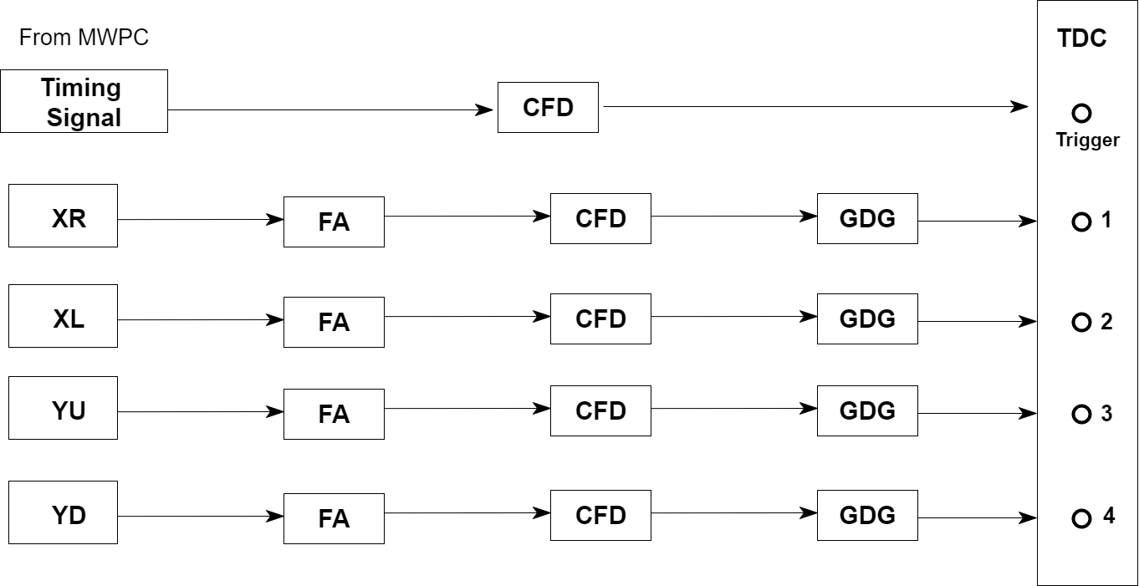

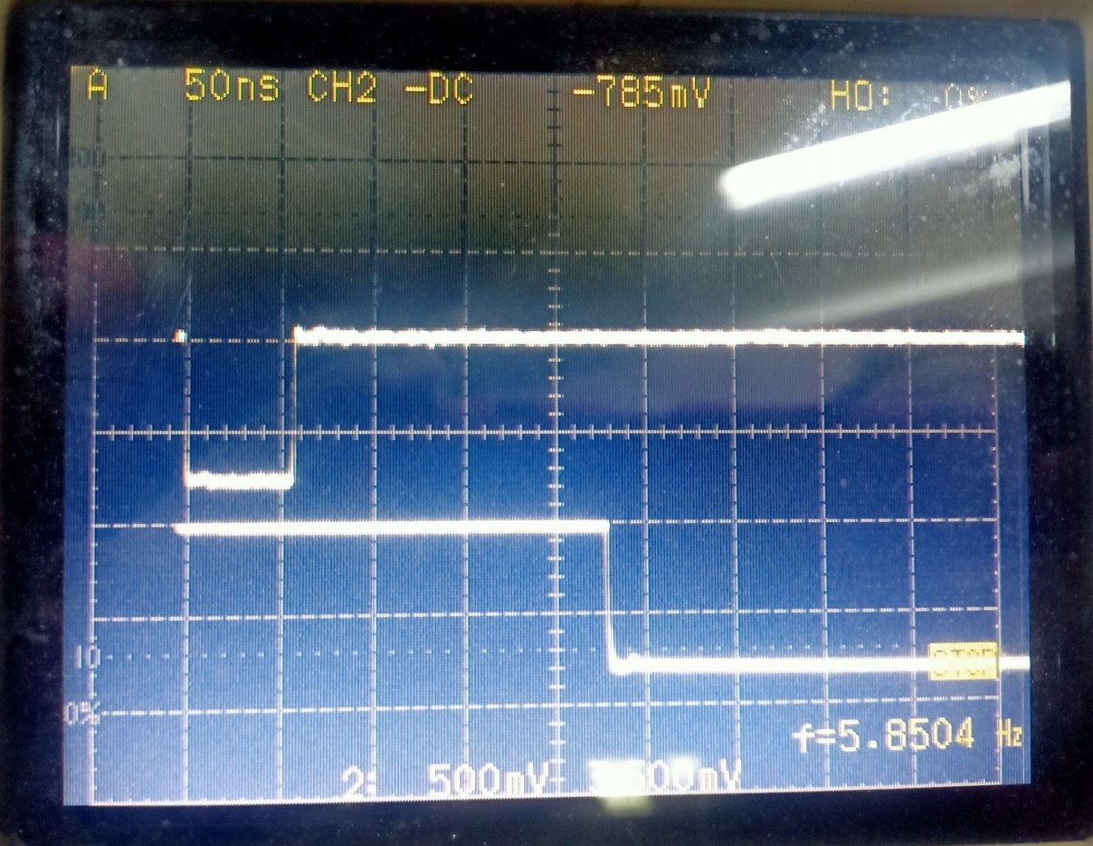
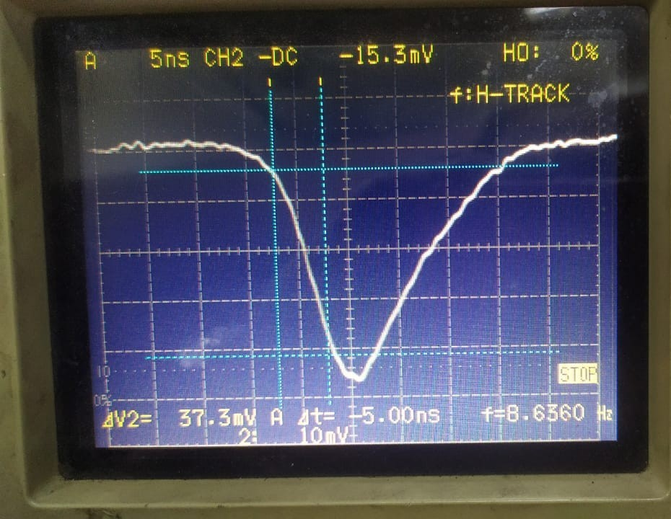
Readout Electronics
Rise Time and Amplitude

Slide 18
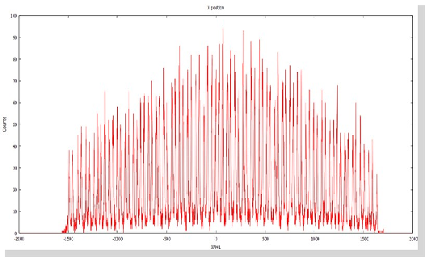
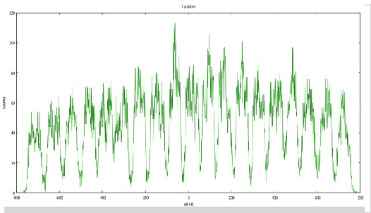
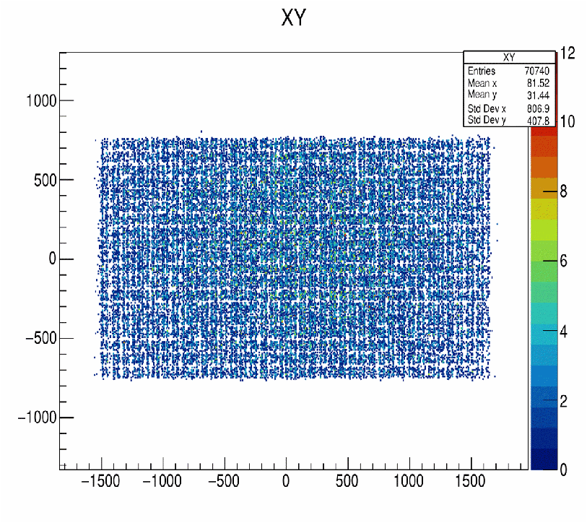
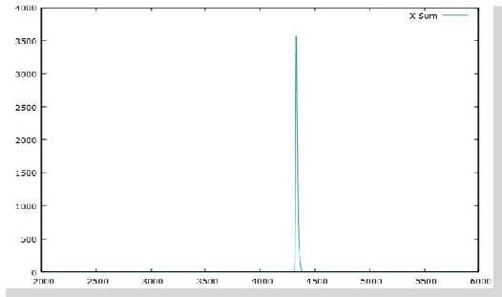
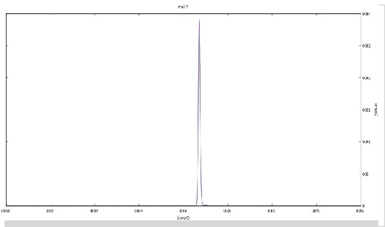
Results
X-position
X-Sum Spectra | Y-Sum Spectra
Y-position
2D plot shows uniform detection of radiation throughout active area
End to end delay is same as induced total delay for both electrodes.
Single peak in sum spectra shows excellent performance of delay lines.

Slide 19

TTime Of Flight (TOF) Measurement

Slide 20
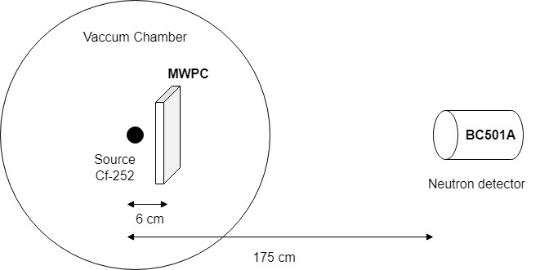
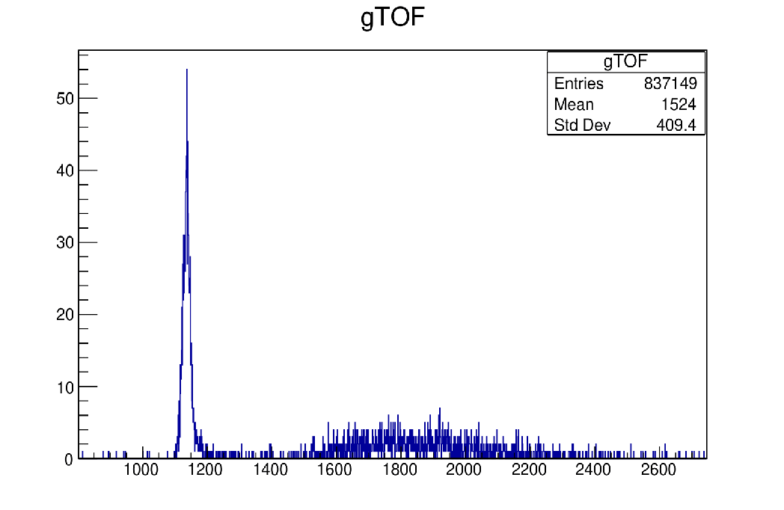
MWPC is paired with BC501A Scintillation detector to measure time resolution
Stronger fission source of Cf-
252 with strength of 10µCi is used and MWPC is operated at a bias voltage of 410V and is kept under a gas flow rate of 5mbar.
The BC501A scintillation neutron detector is kept at a distance of 175cm from the source and detects neutrons and γ-rays from the fission process.
The fission fragment-γ-ray correlation is measured to determine time resolution.

Slide 21


